Slide 1

JUMBLE: An Automated Mutation Testing Tool
Dr. D. P. Mohapatra
Professor
Department of Computer Science & Engineering National Institute of Technology, Rourkela-769008
durga@nitrkl.ac.in

Slide 2
Plan of the Talk
Introduction
History
Example of Jumble Output
Mutations in Jumble
Installation of Jumble
Running Jumble
Common types of errors

Slide 3
Introduction
Jumble is a Java application that
mutates a Java class at the byte-code level and
runs its corresponding unit test to determine the number of killed mutants.
If no tests failed, the mutant lives.

Slide 4
Introduction
After all the results have been tabulated, Jumble returns
a mutation score which is a percentage of all the generated mutants that have been killed.
Additionally, your console output will tell you the details regarding each live mutant.
Jumble is a class level mutation testing tool that works in conjunction with JUnit.

Slide 5
Introduction
The purpose of mutation testing is
to provide a measure of the effectiveness of test cases.
A single mutation is performed on the code to be tested;
the corresponding test cases are then executed.

Slide 6
Introduction
If the modified code fails the tests, then
this increases confidence in the tests.
Conversely, if the modified code passes the tests
this indicates a testing deficiency.

Slide 7
Introduction
JUnit has become the de facto unit testing framework for the Java language.
A class and its corresponding JUnit test is a sensible granularity
at which to apply mutation testing.
With Java, it is feasible to perform mutations at
either the source code or byte-code level.
Jester is a mutation tester operating at the source code level.

Slide 8
Introduction
While Jester proves useful, it is hampered by
the costly cycle of modifying the source,
compiling the source, and
running the tests.
Jumble is a new mutation tester operating directly on class files.
It uses the byte-code engineering library (BCEL) to directly modify class files thereby drastically cutting the time taken for each mutation test cycle.

Slide 9
History
Jumble was developed in 2003-2006 by
a commercial company in New Zealand, Reel Two (www.reeltwo.com), and
is now available as open source under the GPL licence.
At ReelTwo, Jumble is used
on a continuous basis within an agile programming environment
with approximately 400,000 lines of Java code under source control.

Slide 10
History
This checks out project code every fifteen minutes and
runs an incremental set of
unit tests and mutation tests for modified classes.

Slide 11
Example of Jumble Output
Consider a Java class called “Addition”, which has some JUnit tests in a class called “AdditionTest”.
Jumble starts
by running the unit tests (in AdditionTest.class) on the unmodified Addition class
to check that they all pass, and
to measure the time taken by each test.

Slide 12
Example of Jumble Output
Then it will mutate Addition in various ways and
run the tests again
to see if they detect the mutation.
It continues this process until all mutations of Addition have been tried.

Slide 13
Example of Jumble Output
The output might look like this:
Mutating Addition
Tests: AdditionTest
Mutation points = 12, unit test time limit 2.02s
..
M FAIL: Addition:31: negated conditional
M FAIL: Addition:33: negated conditional
M FAIL: Addition:34: - -> +
M FAIL: Addition:35: negated conditional
......
Score: 67%

Slide 14
Example of Jumble Output
This says that Jumble has tried 12 different mutants of Addition and
the unit tests (in Addition Test) correctly detected the changed behaviour in 8/12 cases (indicated by a '.'),
but failed to detect the change in the other 4/12 cases.

Slide 15
Mutations in Jumble
Conditionals
Jumble replaces each condition with its negation.
Thus, for example, the condition x > y would mutate to become !(x > y).
Such mutations are not limited to simple conditionals as in if statements.
They also can occur in loop conditions of while, for, and do loops and in ?: ternary operations.

Slide 16
Mutations in Jumble
Conditionals
The modification of a conditional can cause infinite looping.
Jumble detects this situation by
first timing the test on the unmodified code,
then if the mutated code takes more than a certain multiple of this time
the test is assumed to have caused infinite looping and
the result is deemed to be a pass.
Such results are indicated by a T in the test output.
Jumble always mutates conditionals.

Slide 17
Mutations in Jumble
Binary Arithmetic Operations
Jumble can replace binary arithmetic operations for
either integer or floating-point arithmetic with another operation.
The replacement operation is selected according to the table below.
Fixed replacements rather than random replacements are used
because sometimes different operations will (correctly) produce the same result.
Even when using the fixed replacements of the table such a situation can occasionally arise.

Slide 18
Mutations in Jumble
Jumble always mutates binary arithmetic operations.
Current | Mutation
+ | -
- | +
* | /
/ | *
% | *
& | |
| | &
^ | &
<< | >>
>> | <<
>>> | <<

Slide 19
Mutations in Jumble
Increments:
Increments, decrements, and the assignment increments and decrements are mutated to their opposite sign.
For example, i++ becomes i--.
This mutation is off by default,
but can be turned on using the "-i" or "--increments" command-line flags.

Slide 20
Mutations in Jumble
Inline Constants
Jumble can change the value of literal constants used in const instructions and various push instructions.
Because Jumble cannot tell from the class file whether such constants are ints, shorts, characters, bytes, or booleans,
some confusion can occur when interpreting the output of these mutations.

Slide 21
Mutations in Jumble
Inline Constants
If the mutated value happens to corresponding to a printable ASCII character then
this value appears in parenthesis after the numerical value.
A value of 0 might also be a boolean false and a value of 1 a boolean true.
The mutation of inline constants is off by default,
but can be turned on using the "-k" or "--inline-consts" command-line flags.

Slide 22
Mutations in Jumble
Class Pool Constants
Jumble can change the value of literal constants and strings that appear in the "class pool" of a class.
Primitive literals (ints, doubles etc.) are mutated in a similar way to inline constants, and
string literals are replaced by the string "__jumble__" or "___jumble___".
The mutation of constant pool entries is off by default,
but can be turned on using the "-w" or "--cpool" command-line flags.

Slide 23
Mutations in Jumble
Return Values
Jumble can change return values.
For primitive booleans, shorts, characters, integers, floats, and doubles
non-zero returns can be changed to 0 and
0 returns are changed to 1.

Slide 24
Mutations in Jumble
Return Values
For objects
non-null returns can be changed to null;
for null returns a RuntimeException is invoked (this is because Jumble cannot reliably instantiate a valid object or arbitrary type).
This mutation is off by default,
but can be turned on using the "-r" or "--return-vals" command-line flags.

Slide 25
Mutations in Jumble
Switch Statements
Jumble can mutate each case of a switch statement
by swapping it with the default case or another case, or
by changing the case value.
This mutation is off by default,
but can be turned on using the "-j" or "--switch" command-line flags.

Slide 26
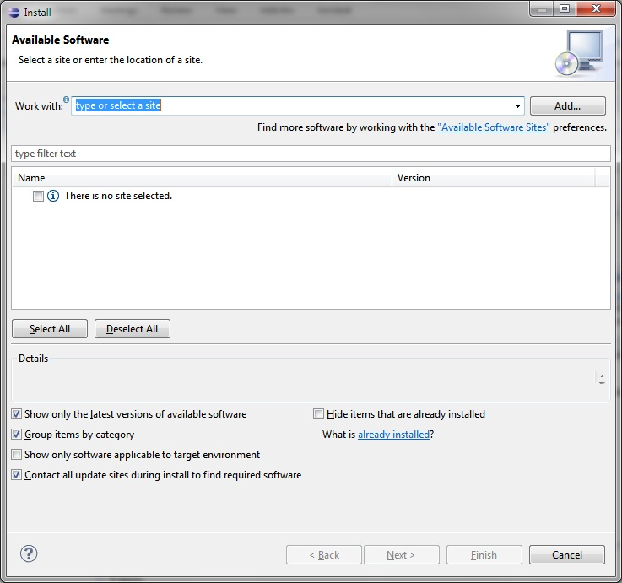
Installation of Jumble
Open Eclipse Juno
Go to Help button
Click on Install New Software.

Slide 27
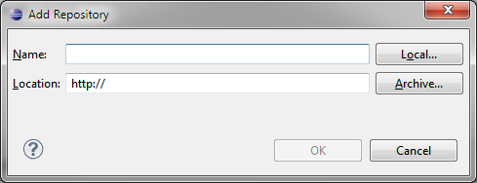
Installation of Jumble
Click on Add button, a pop-up message box will come

Slide 28
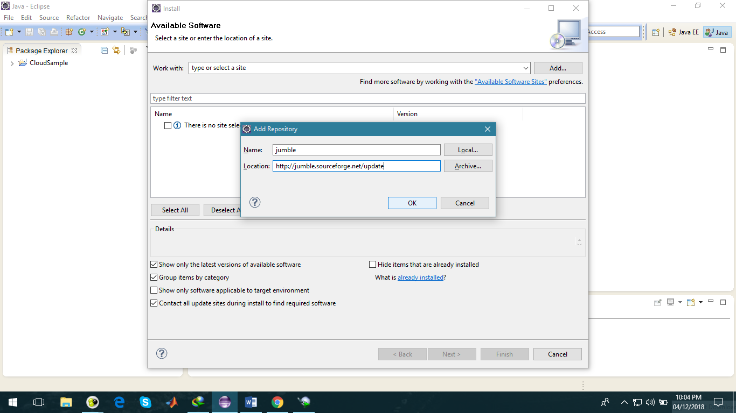
Installation of Jumble
Give the project name as Jumble and paste the below URL in Location text box.
http://jumble.sourceforge.net/update/
Then click Ok.

Slide 29
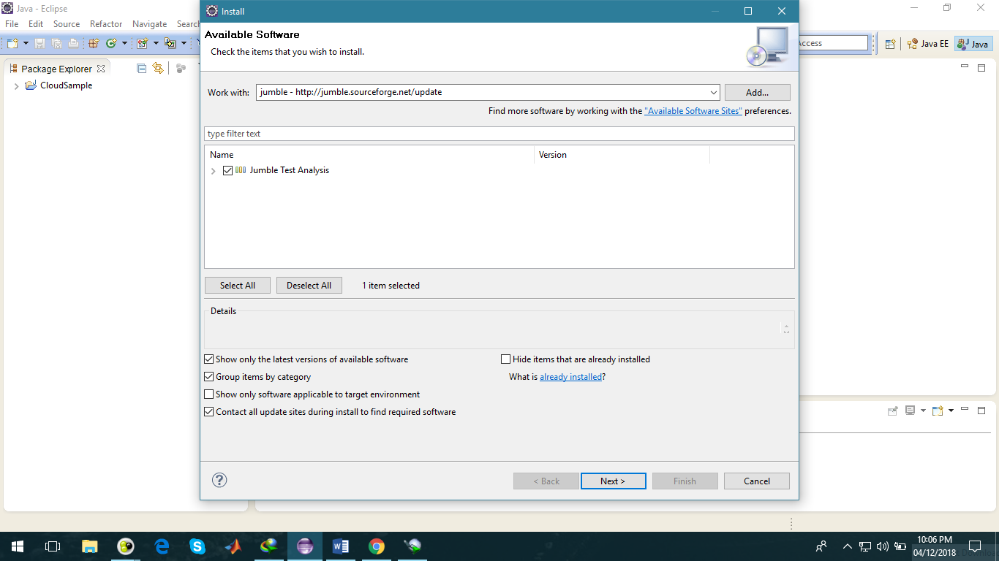
Installation of Jumble
Select Jumble for Eclipse
click on Next button.

Slide 30
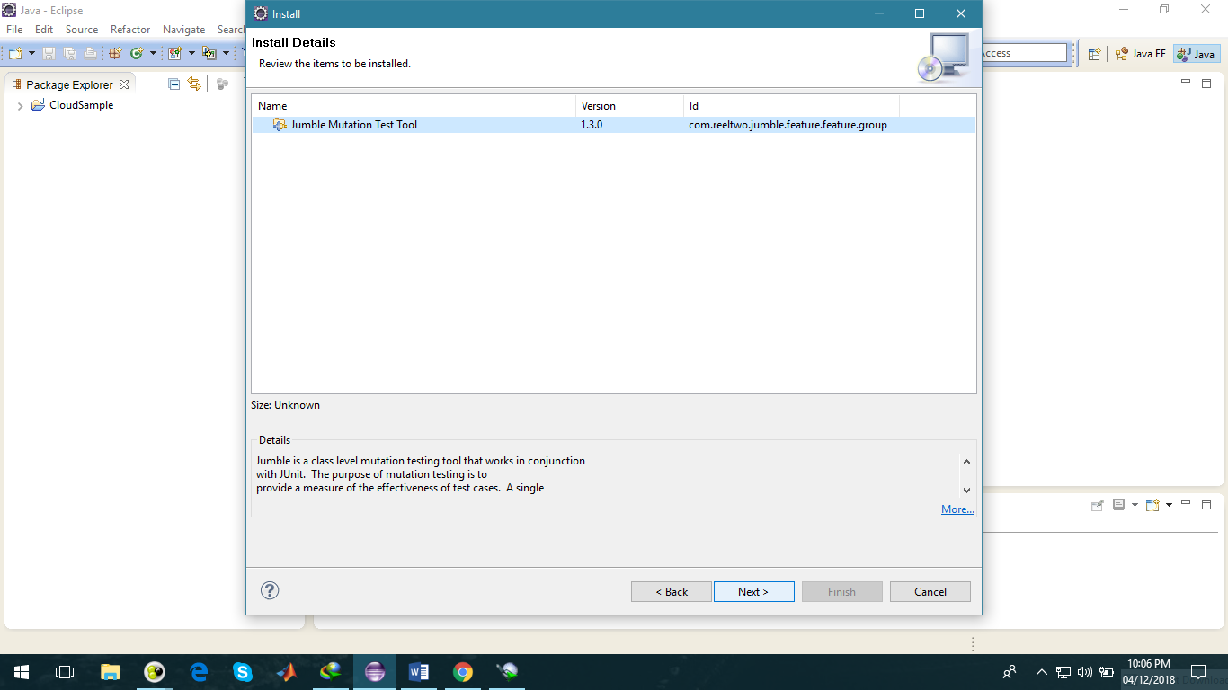
Installation of Jumble
After calculating the requirements and dependencies, a new window will come.
Then click on Ok.

Slide 31
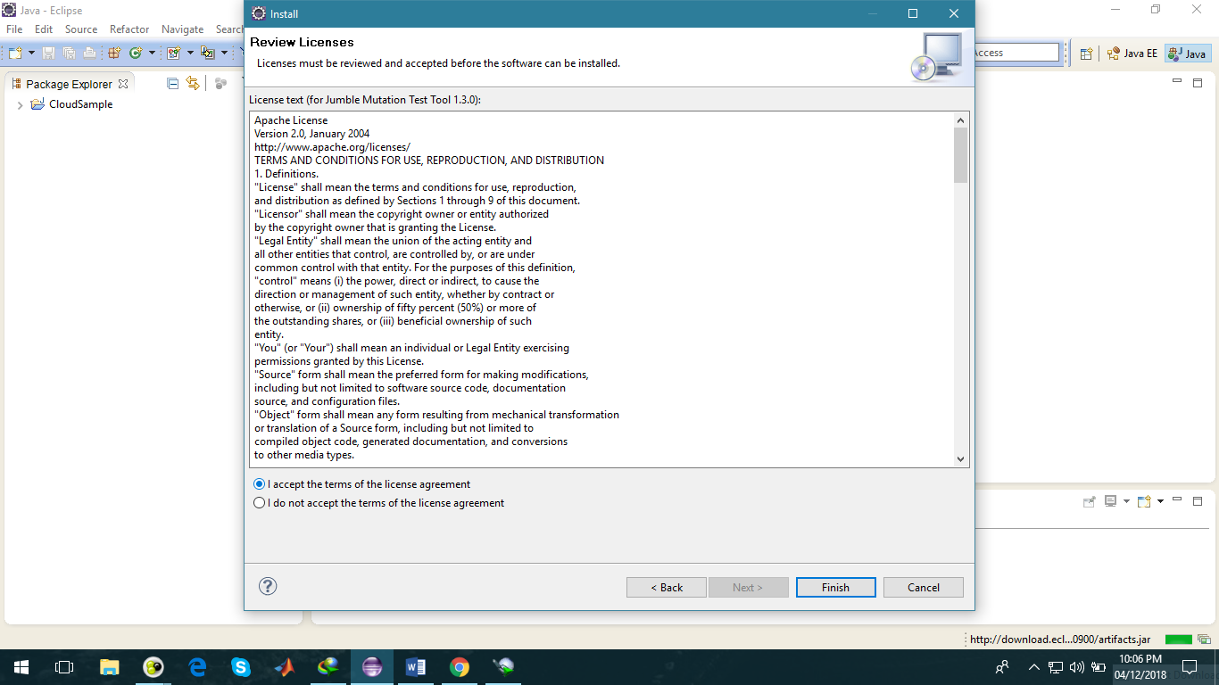
Installation of Jumble
Select I accept the terms of the license of agreement and
click Next button.

Slide 32
Installation of Jumble
A new frame will appear which has the Jumble feature and the install location.
NOTE: Be sure the install location is the default Eclipse directory!
Then installation of software will start.
Wait till it completes and then click on Finish button.

Slide 33
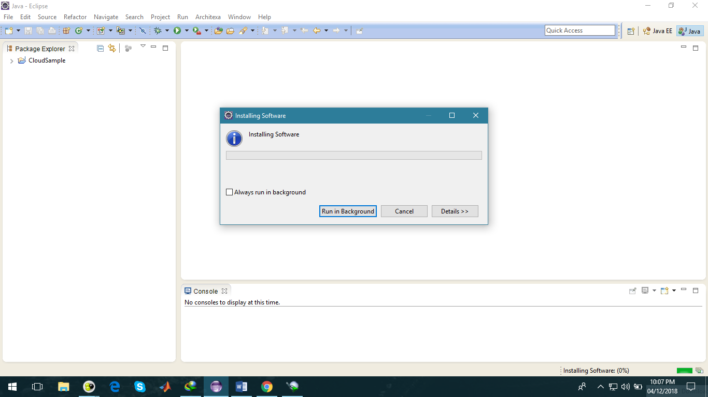
Installation of Jumble
In between this installation process, if any pop-up window will come to allow the access,
then click on Allow access.

Slide 34
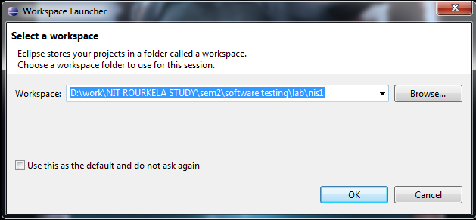
Running Jumble
Open the eclipse MARS
Create a new work space

Slide 35
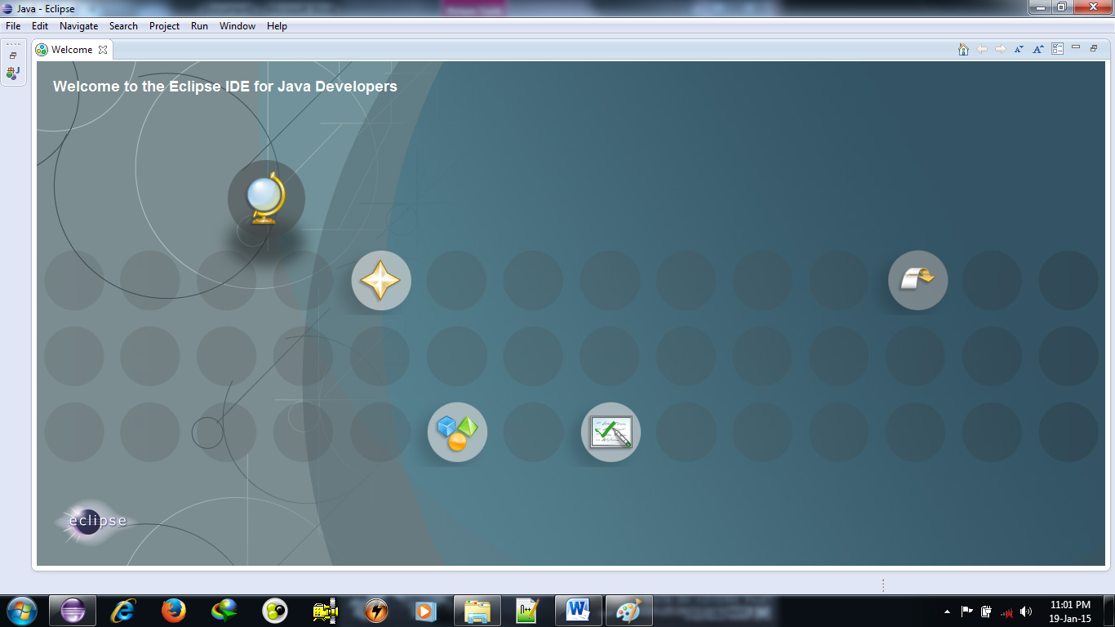
Running Jumble
A screen will appear as shown

Slide 36
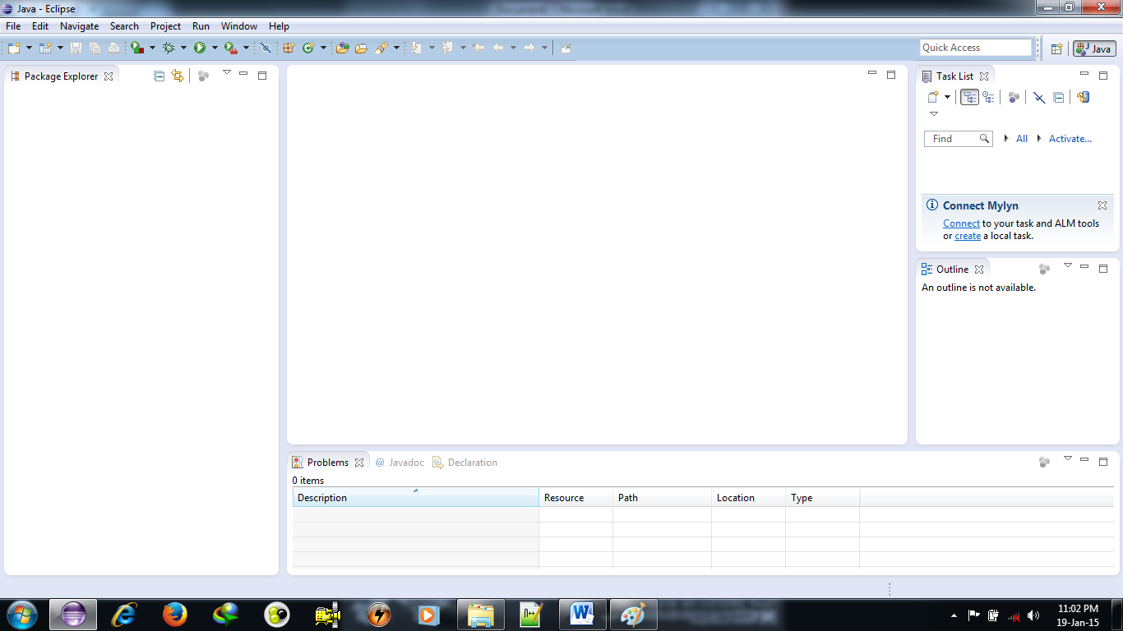
Running Jumble
Close the welcome screen.
After closing this, now screen will become as

Slide 37
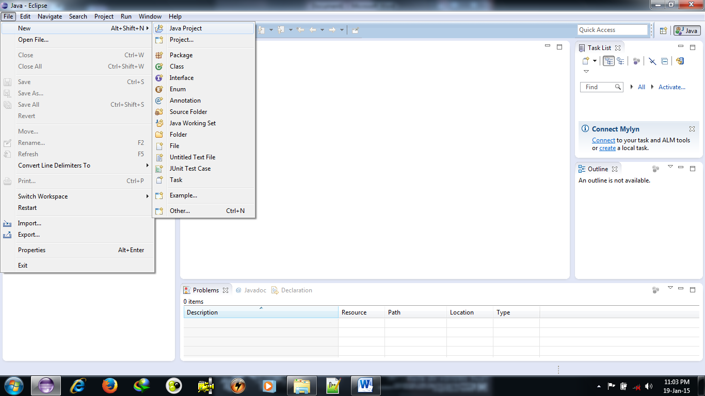
Running Jumble
Go to File->New->Java Project

Slide 38
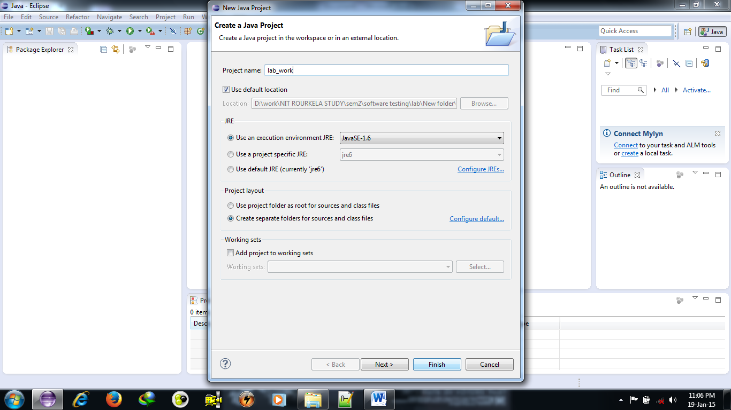
Running Jumble
Give the project name (e.g. “lab_work” )
Then click Finish

Slide 39
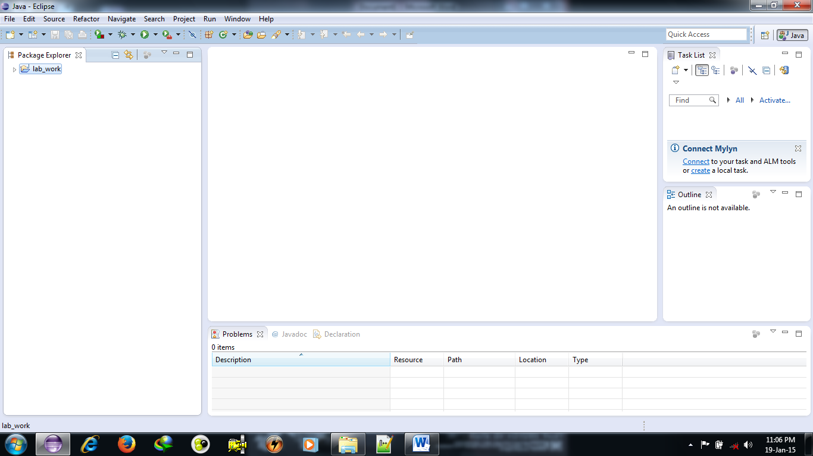
Running Jumble
On clicking Finish
project will be created and
displayed in project explorer on the left hand side of the window

Slide 40
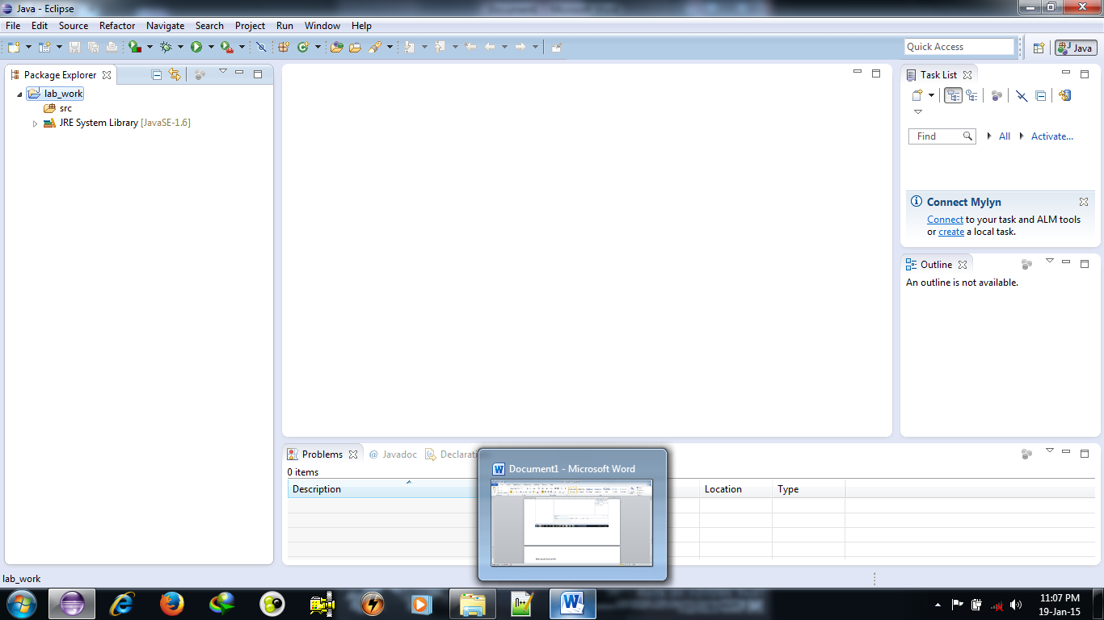
Running Jumble
Then expand your project

Slide 41
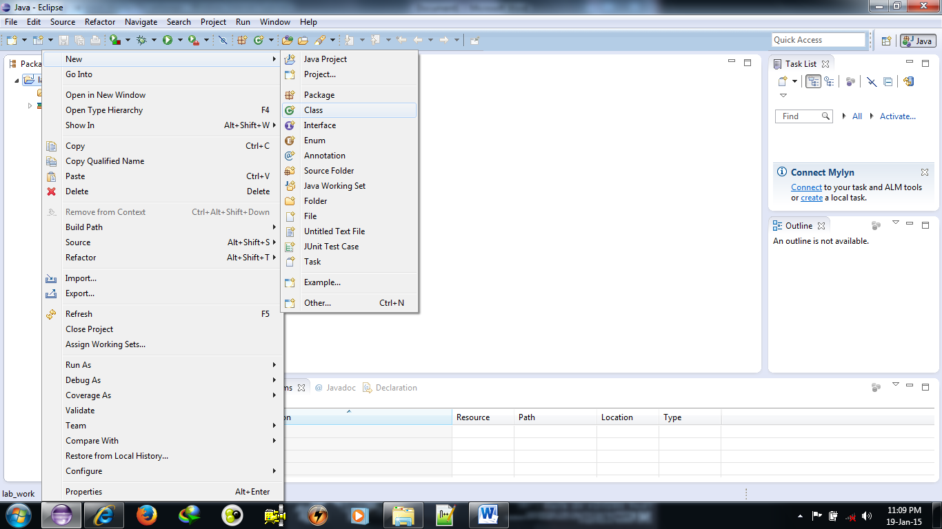
Running Jumble
Right click on the project and
then new→class

Slide 42
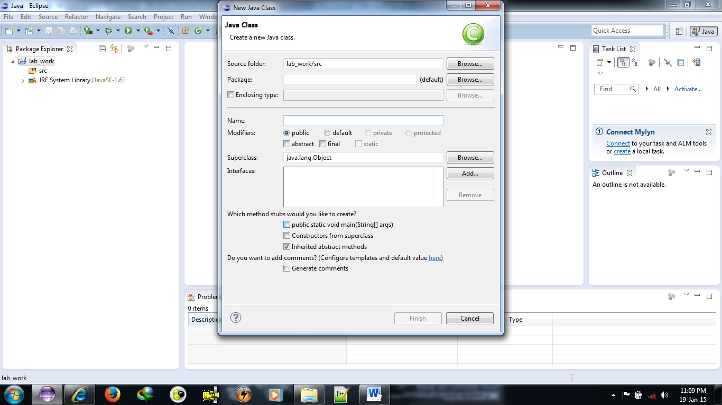
Running Jumble
New window will be open as shown in figure.
Enter class name and package name.
Then click Finish

Slide 43
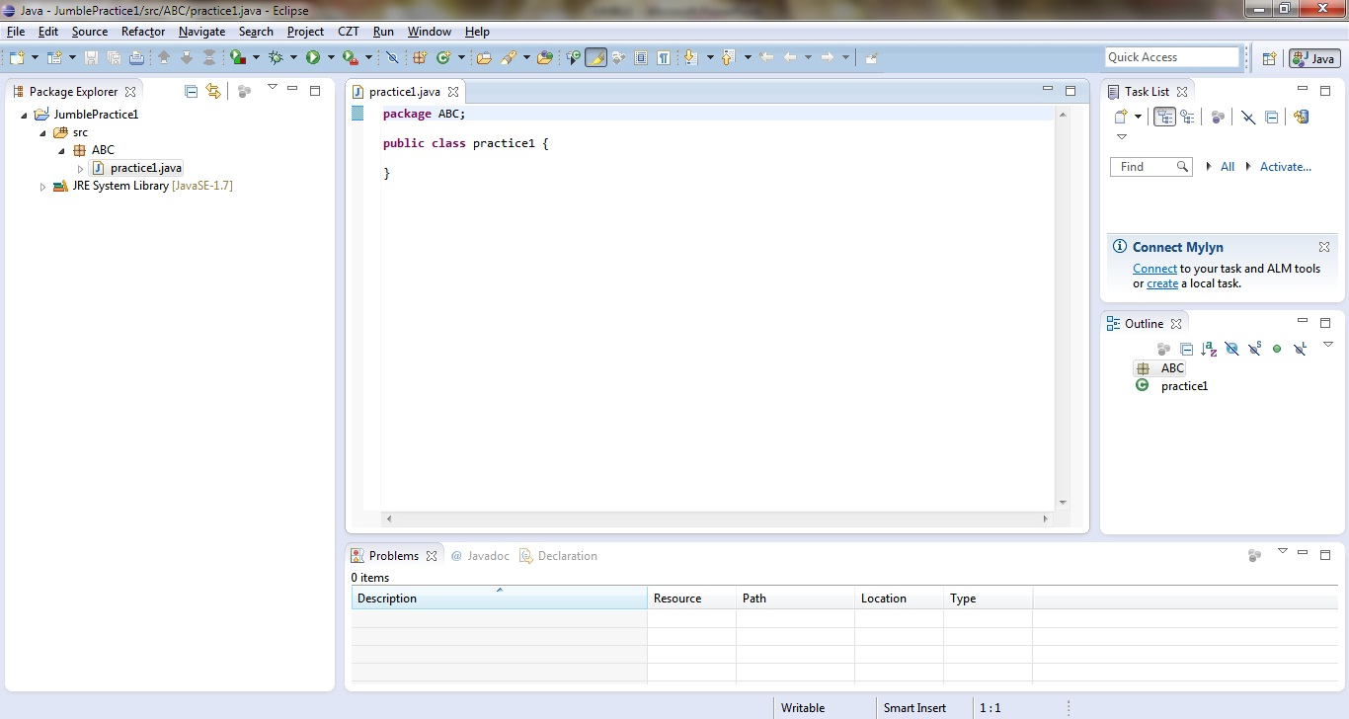
Running Jumble
Now the screen appeared as
write down the code for factorial.java without the main function.

Slide 44
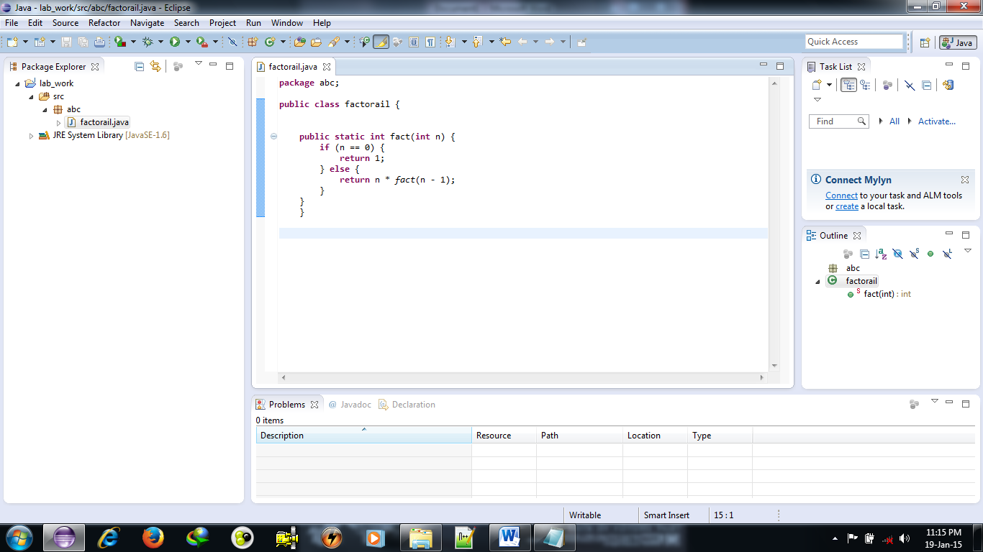
Running Jumble
After completing save this.

Slide 45
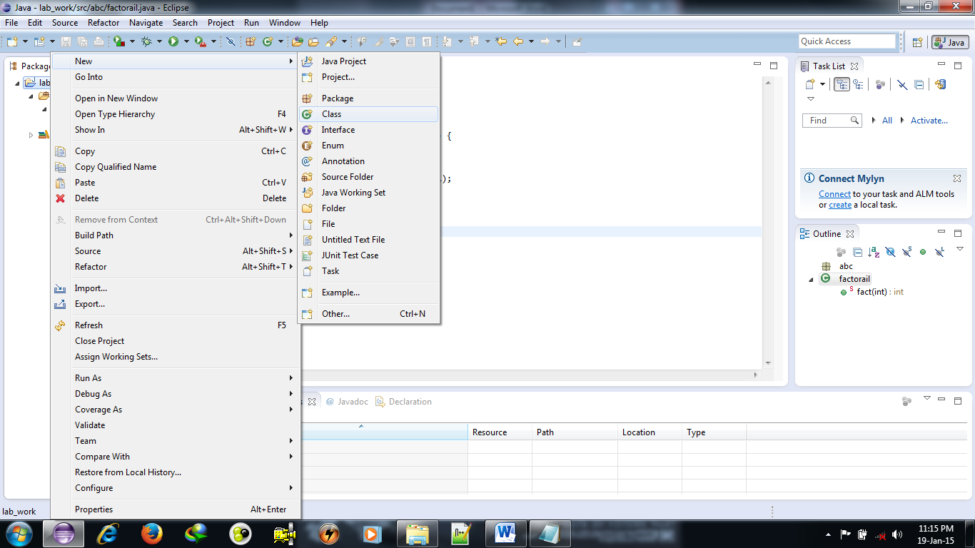
Running Jumble
Now again right click on project
then new→ class

Slide 46
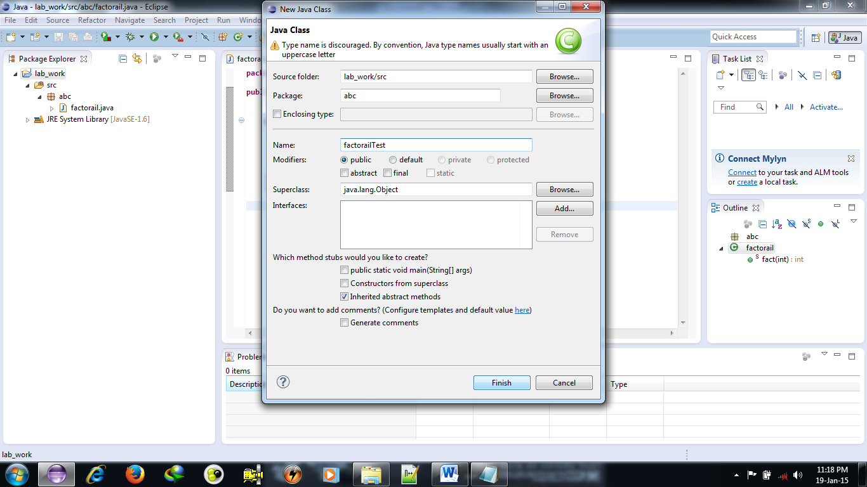
Running Jumble
Give the name as factorialTest.java within the same package.

Slide 47
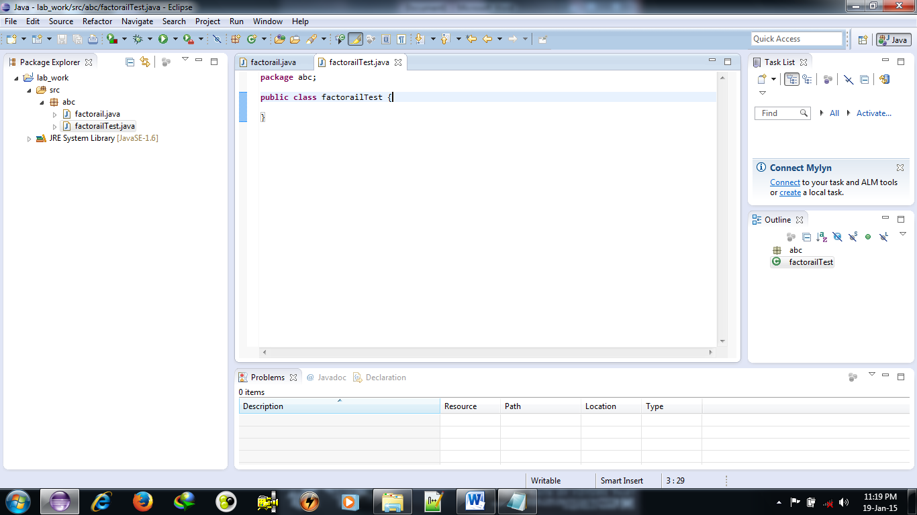
Running Jumble
Click finish. Now screen appear to be as shown

Slide 48
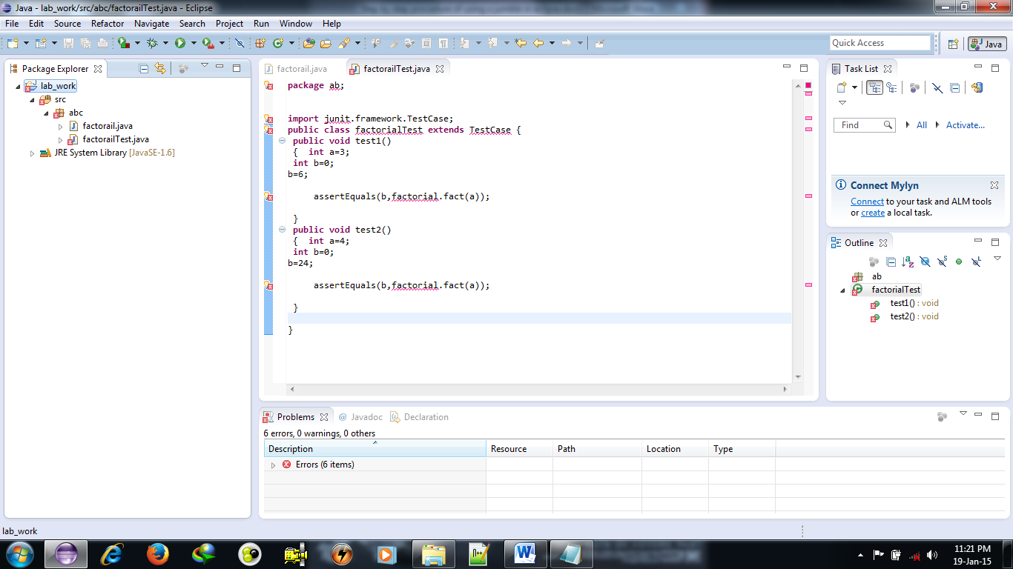
Running Jumble
Write the code for test class and save it.

Slide 49
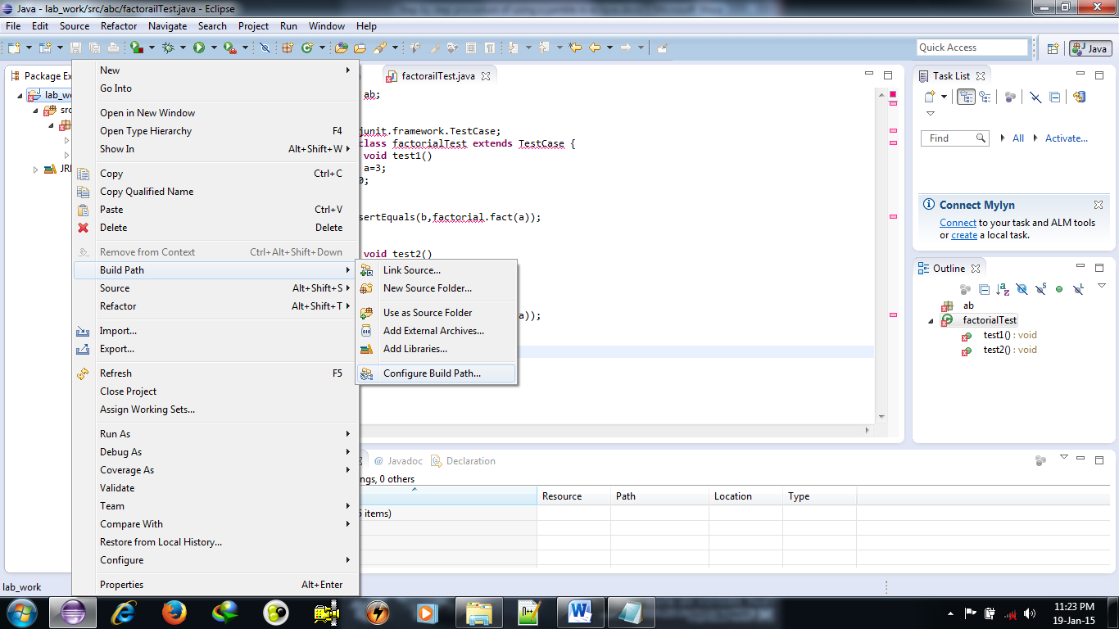
Running Jumble
Since many errors appear
build the path by right click on the project then
select build path → configure Build path

Slide 50
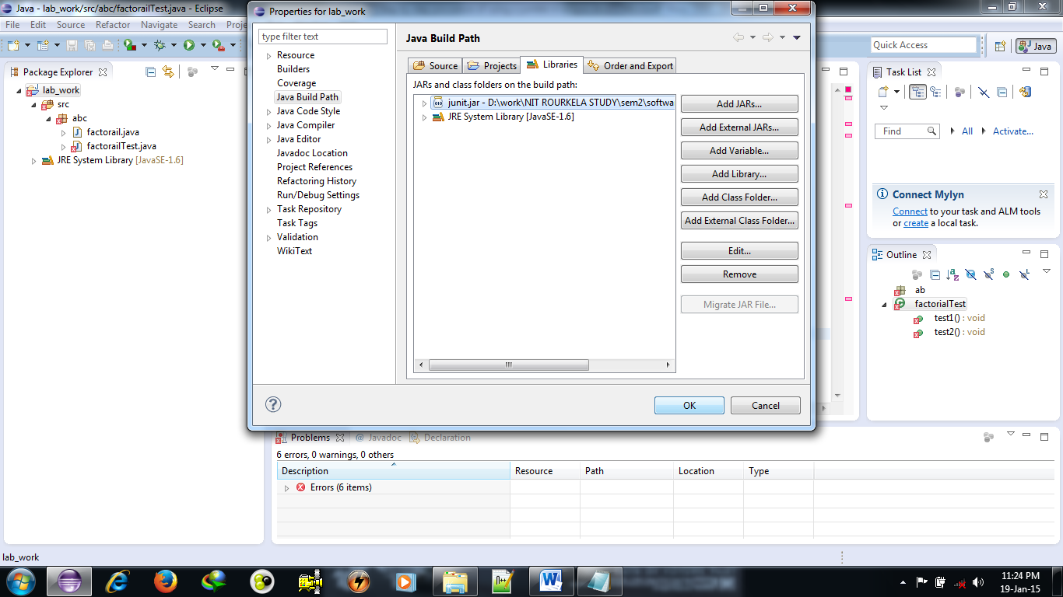
Running Jumble
New screen appear as
Now add external JAR file to library and click ok.

Slide 51
Running Jumble
JAR files can be downloaded from the given link
http://sourceforge.net/projects/jumble/files/
JAR file of Junit can be downloaded from below link
http://junit.org/
then click on Download and Install and download junit.jar.

Slide 52
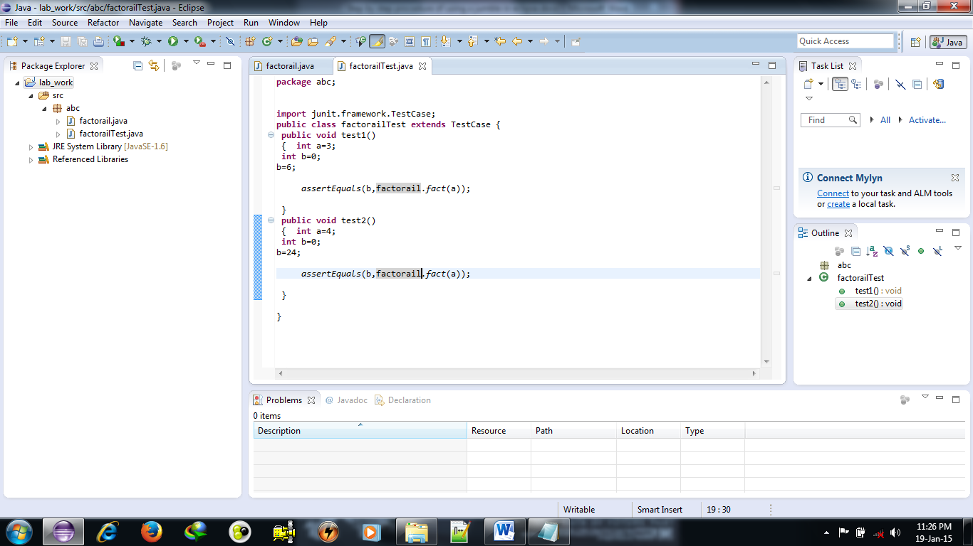
Running Jumble
Now error will not be there

Slide 53
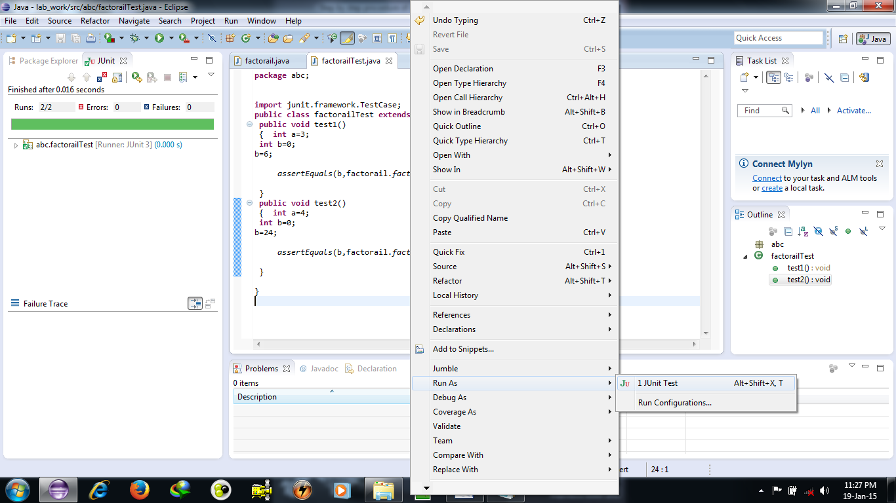
Running Jumble
Run test file as JUnit test.
On left side, green colour will indicate successful

Slide 54
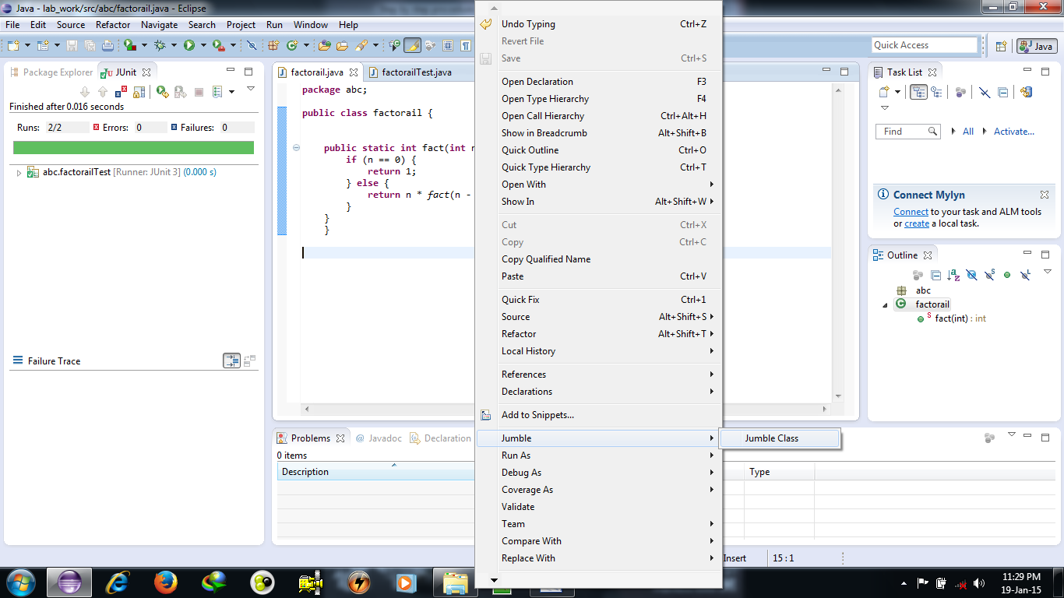
Running Jumble
Now go to factorial.java then
right click→ jumble →jumble class

Slide 55
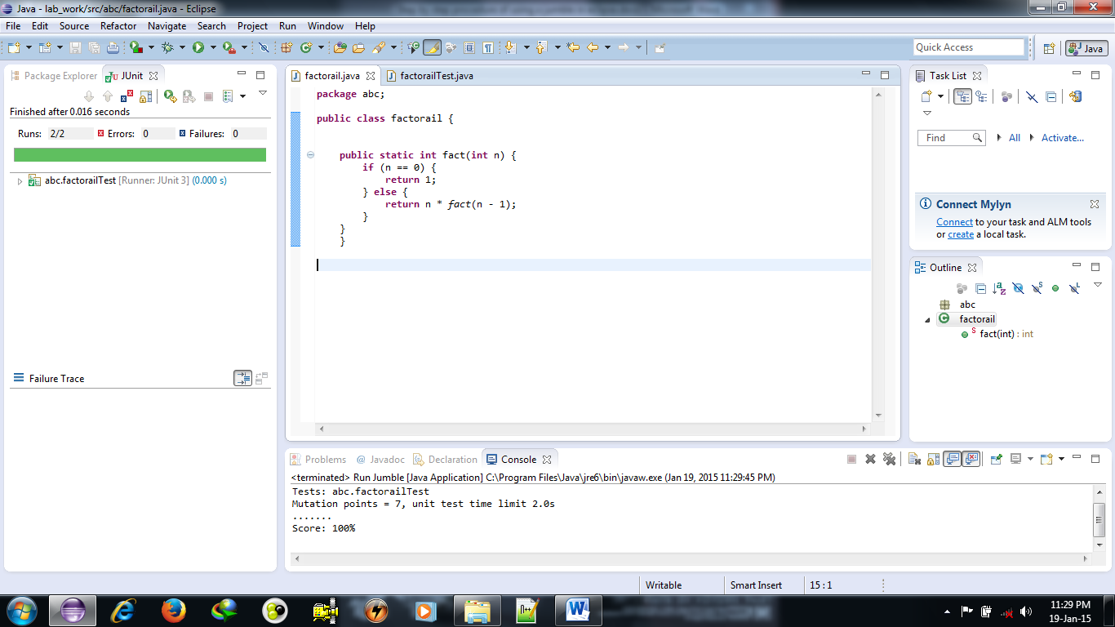
Running Jumble
At the bottom mutation score will be displayed

Slide 56
Running Jumble
factorial.java
package abc;
public class factorial{
public static int fact(int n){
if(n==0){
return 1;
}
else{
return n*fact(n-1);
}
}
}
factorialTest.java
package abc;
import junit.framework.TestCase;
public class factorialTest extends TestCase{
public void test1(){
int a=3;
int b=6;
assertEquals(b,factorial.fact(a));
}
public void test2(){
int a=4;
int b=24;
assertEquals(b,factorial.fact(a));
}
}

Slide 57
Common types of errors
TEST CLASS IS BROKEN
This occurs when
all the test cases do not pass.
So all the test cases needed to be passed.
NO TEST CLASS FOUND
This occurs when
JUnit does not find appropriate test suite.

Slide 58
Common types of errors
The test class name must be same as actual class name which needed to be tested and
it should be preceded by “Test”.
For example, if class name is “Sum”, then
The corresponding test class name should be “SumTest”.
The actual class and its corresponding test case must be in same package.

Slide 59
EclEmma : Java Code Coverage for Eclipse
EclEmma is a free Java code coverage tool for Eclipse, available under the Eclipse Public License. It brings code coverage analysis directly into the Eclipse workbench:
Fast develop/test cycle: Launches from within the workbench like JUnit test runs can directly be analysed for code coverage.
Rich coverage analysis: Coverage results are immediately summarized and highlighted in the Java source code editors.
Non-invasive: EclEmma does not require modifying your projects or performing any other setup.

Slide 60
EclEmma : Java Code Coverage for Eclipse
Analysis
On request or after your target application has terminated code coverage information is automatically available in the Eclipse workbench:
Coverage overview: The Coverage view lists coverage summaries for your Java projects, allowing drill-down to method level.
Source highlighting: The result of a coverage session is also directly visible in the Java source editors. A customizable colour code highlights fully, partly and not covered lines. This works for your own source code as well as for source attached to instrumented external libraries.

Slide 61
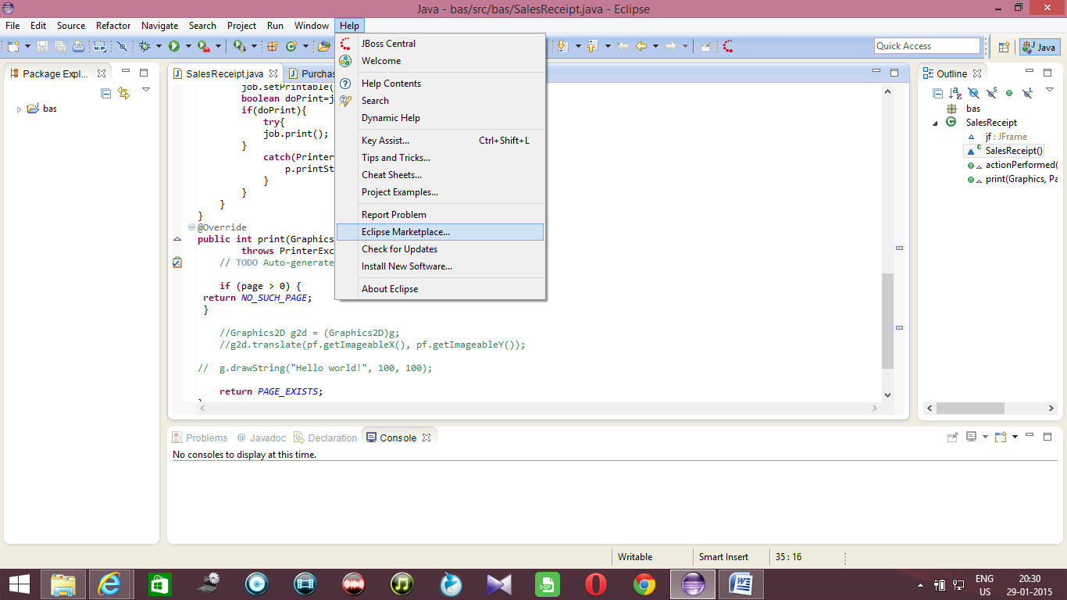
Installation of EclEmma in Eclipse
1. Help->Eclipse Marketplace

Slide 62
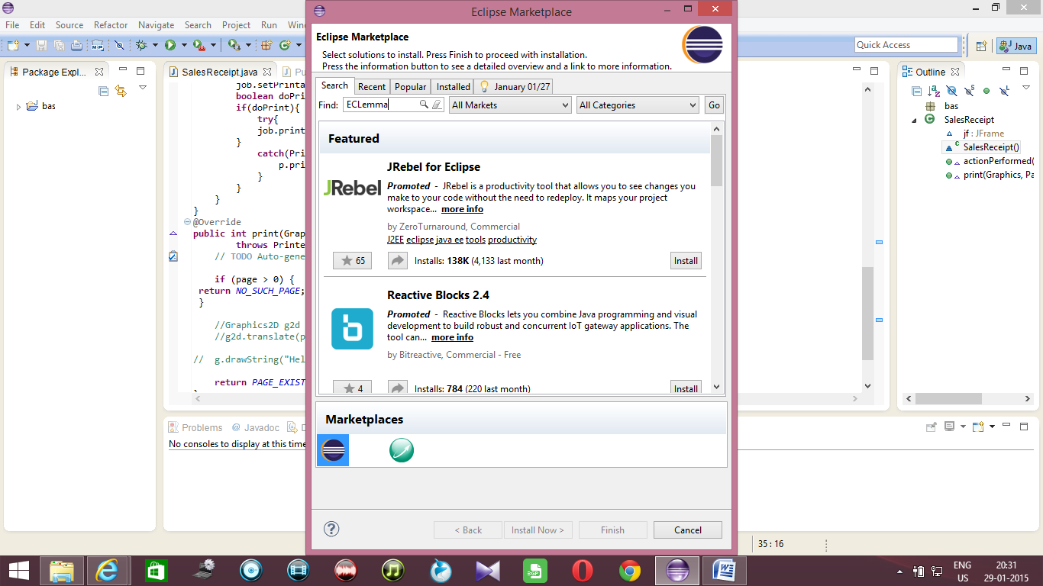
Installation of EclEmma in Eclipse
2. Type: ECLemma and Click on “Go”

Slide 63
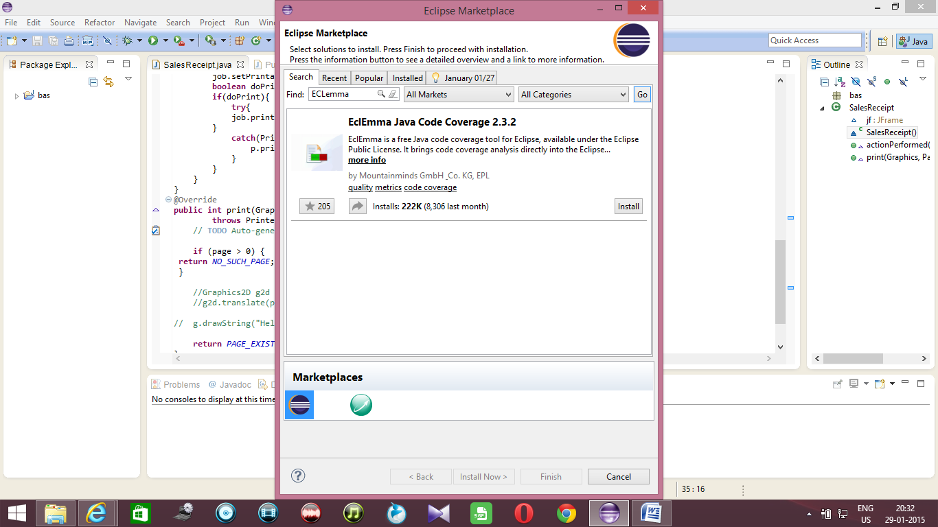
Installation of EclEmma in Eclipse
3. Click on install

Slide 64
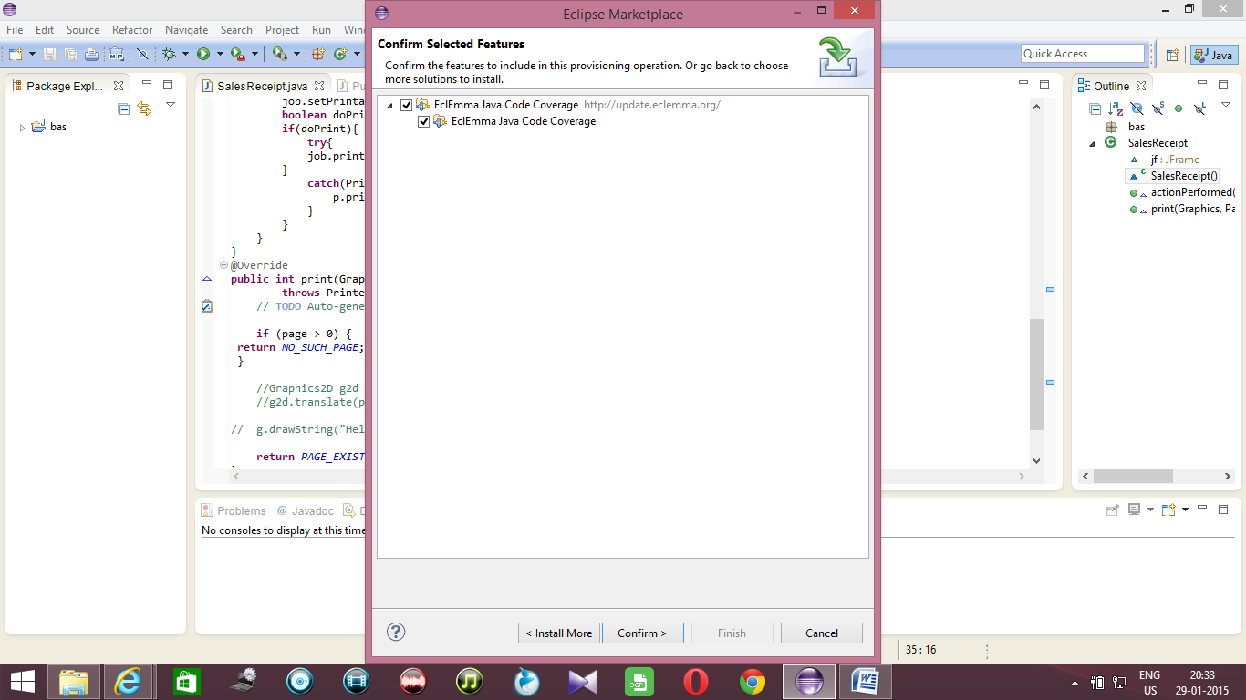
Installation of EclEmma in Eclipse
4. Click on confirm.

Slide 65
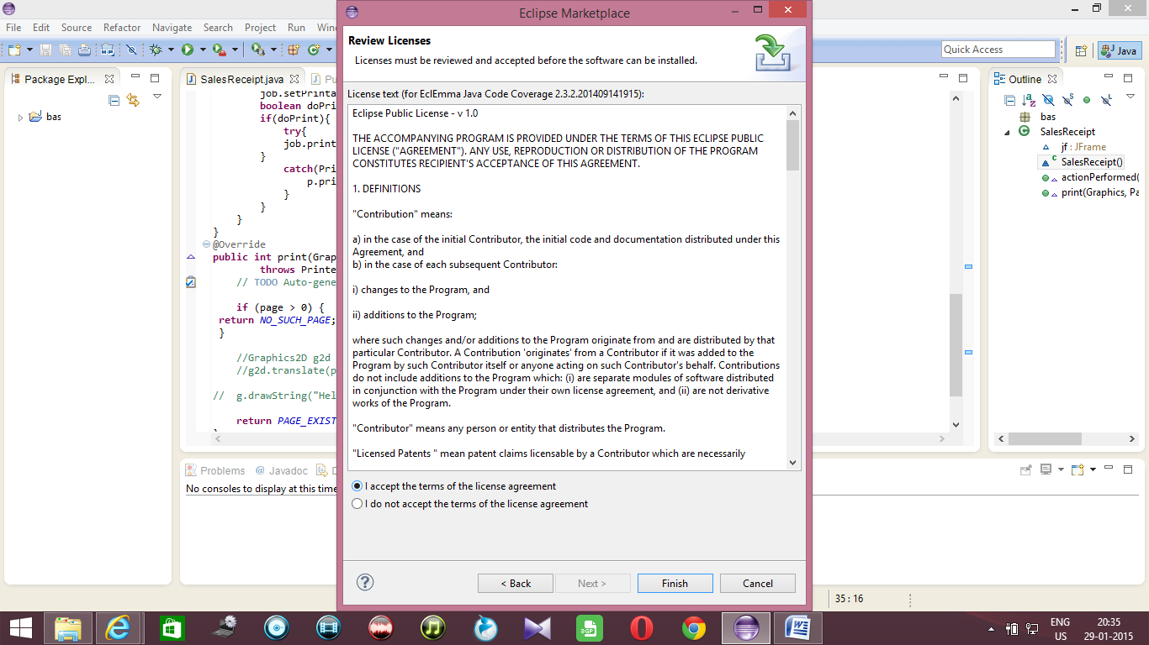
Installation of EclEmma in Eclipse
5. Select “I accept the ...” and then click on Finish.

Slide 66
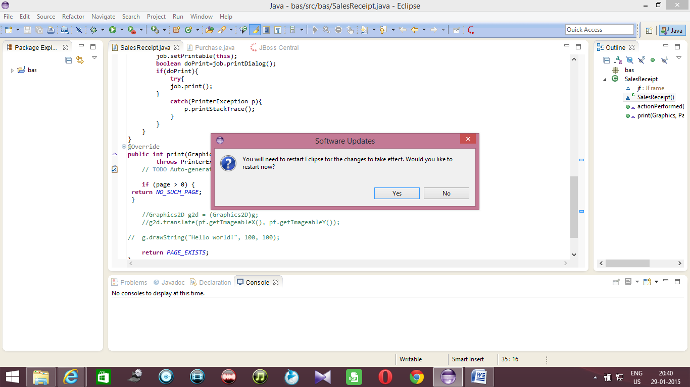
Installation of EclEmma in Eclipse
6. Restart Eclipse by clicking on “Yes”

Slide 67
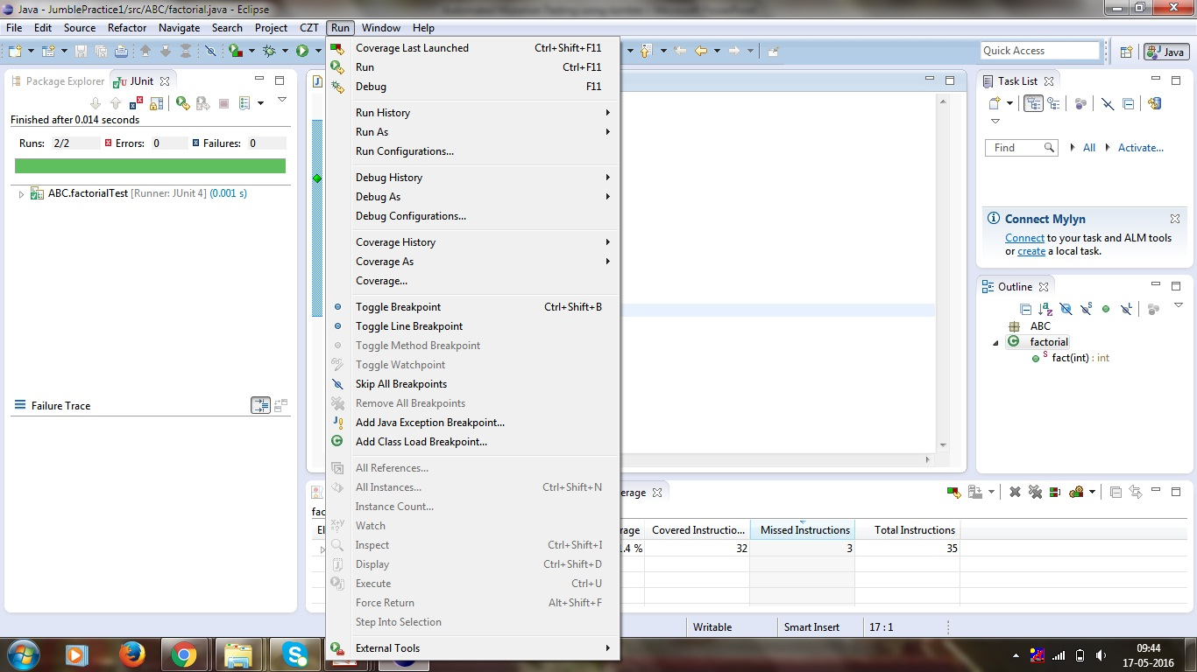
Installation of EclEmma in Eclipse
7. After Restart, you will see the following

Slide 68
Implementation of EclEmma
factorial.java
package abc;
public class factorial{
public static int fact(int n){
if(n==0){
return 1;
}
else{
return n*fact(n-1);
}
}
}
factorialTest.java
package abc;
import junit.framework.TestCase;
public class factorialTest extends TestCase{
public void test1(){
int a=3;
int b=6;
assertEquals(b,factorial.fact(a));
}
public void test2(){
int a=4;
int b=24;
assertEquals(b,factorial.fact(a));
}
}

Slide 69
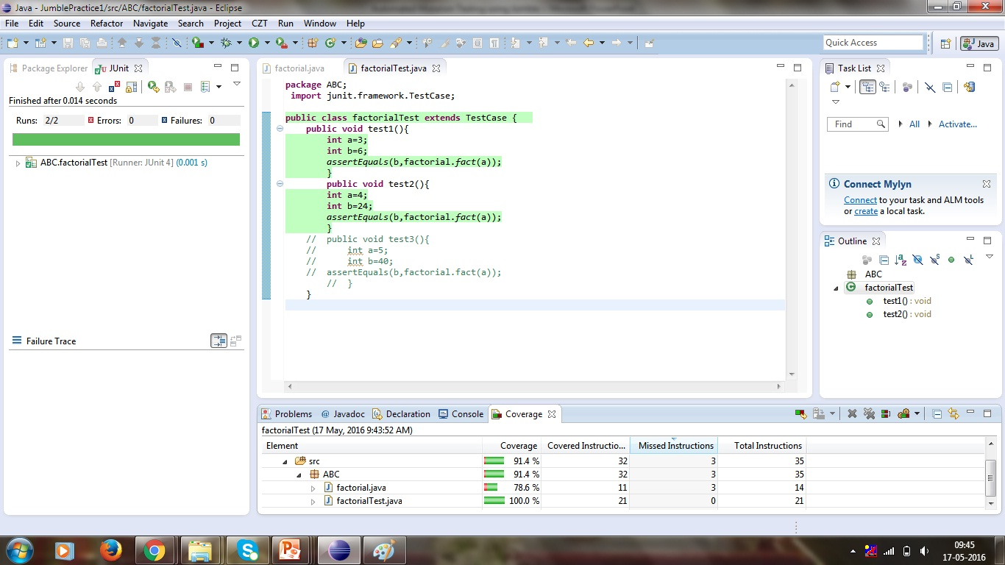
Implementation of EclEmma

Slide 70
Frequently Asked Questions
1. What does a dot(.) output mean ?
It means that the test cases detected the mutation. This is good.
2. What does a M output mean ?
It means that the mutation (which follows the M) was not detected by the test cases. This generally indicates the tests are in some way deficient.
3. What does a T output mean ?
The mutation caused the unit tests to take much longer than expected (possibly having put the code into an infinite loop). Jumble gives the tester the benefit of the doubt in such situations, and counts this mutation as having been detected.
4. Can Jumble ever incorrectly report an arithmetic problem ?
Yes. Certain combinations of operations and constants give the same result for different examples. For example,
y = x * sign;
y = x / sign;
give the same result for sign = 1 or sign = -1.

Slide 71
Frequently Asked Questions
5. Why does Jumble only make one mutation at a time ?
A single mutation is generally harder for a test class to detect than multiple simultaneous mutations. Also, if multiple mutations were made there is a slight chance they would cancel each other out.
6. Is any code exempt from mutation ?
Jumble tries not to make mutations within assertions. Specific methods can also be excluded from testing, by default main and integrity are excluded.
7. Can I Jumble an interface ?
Not really, since an interface contains no code to mutate. Jumble will report a score of 100% for interfaces.

Slide 72
THANK YOU

